Slide 1

Market Analytics: Methanol & Derivatives – 2020
Abstract
Please view in Slide Show
Markets and Profitability
June 2020

Slide 2
Analysis and forecast of supply and demand in the global methanol market
Report Scope
Report Scope
Report Contents
Product Scope:
The methanol and derivatives report includes methanol, formaldehyde, MTBE and acetic acid.
Geographic Scope:
Global
North America
South America
Western Europe
Central Europe
Eastern Europe
Middle East
Africa
Asia Pacific
Section 1: The Methanol Industry
Section 2: Methanol
Section 3: Formaldehyde
Section 4: Methyl tert-Butyl Ether (MTBE)
Section 5: Acetic Acid
Note: Sections 2-5 are segmented by geographic region and have the following outline
2.1.1. Consumption
2.1.2. Supply
2.1.3. Supply, Demand and Trade
Includes long term forecasts to 2045.

Slide 3
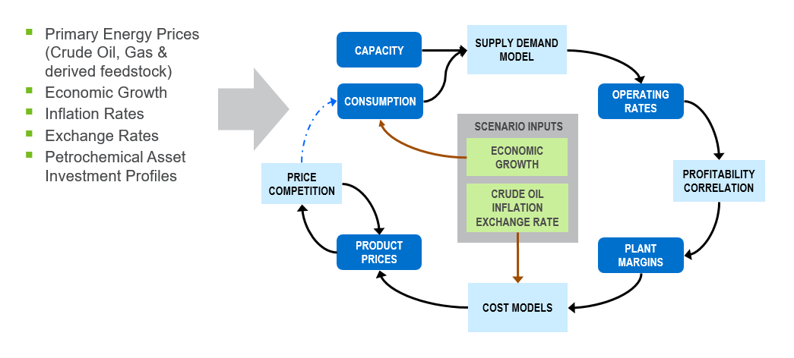
Markets and prices are inherently linked. Economic growth shapes markets via consumption. Crude oil drives costs
Methodology
Scenario Definition
Nexant Petrochemical Simulator
Nexant's Petrochemical Simulator tests assumptions of volatile operating environments with proven methodology.

Slide 4
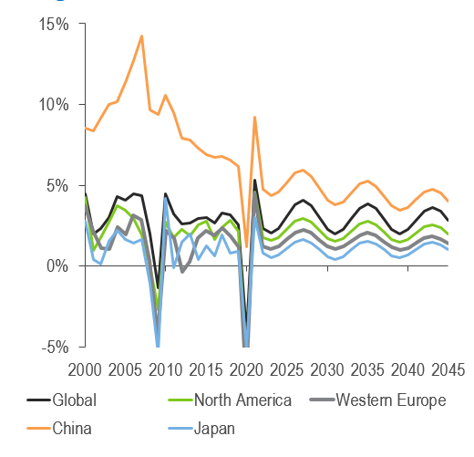
Global economic growth dropped to 2.5 percent in 2019, but is expected to contract by 4.2 percent in 2020
Underlying GDP Outlook
Regional GDP Outlook
    The impact of confinement measures will be an unprecedented contraction in the global economy.
    Those countries which successfully contained the outbreak already emerged from confinement and have achieved a rapid recovery in economic activity.
    Brazil and the United States have the largest ongoing infection rates, and infection rates in Africa are accelerating.
    Further confinement measures may be required to contain a second wave of infections.
    Minimal evidence of positive impact from lower oil prices.
    Growth over the coming years will be limited by high debts and job losses.

Slide 5
Summary of Methanol and Derivatives Developments
The COVID-19 pandemic will cause 0% methanol demand growth in 2020
    This is remarkable given that methanol has averaged at 8.8 percent growth per year since 2015.
    The market was already entering a period of oversupply with many capacity additions prior to the pandemic; the loss of demand growth in 2020 will exacerbate this.
    Formaldehyde and direct fuel demand will decline in 2020, but completed derivative capacity in olefins will offset 2020 declines, with inventory migrating down the value chain.
    Indications are the there have been good sales of olefins, with polyolefin purchasers continuing to purchase resin and build inventory.
    Key petrochemical building blocks ethylene and propylene, and the diversity of those olefin derivatives, will protect long term market growth.
    The 3:1 ratio of methanol:olefin will mean large volumes of methanol are required on the merchant market.
    Bio based routes harnessing waste as feedstock or renewable power are being explored in Europe.
The COVID-19 pandemic will cause the demand of key derivatives to decrease
    Global formaldehyde demand will contract by 3 percent.
    Global acetic acid demand will decrease by 3 percent.
    MTBE demand will decrease, but there has been much investment in MTBE capacity in the last 18 months. There will be much less trade as Asia can supply much more of its domestic market.
    China’s MTBE demand will face competition from ethanol mandates in the forecast, but China’s gasoline pool is not expected to achieve a 10 percent ethanol content.

Slide 6
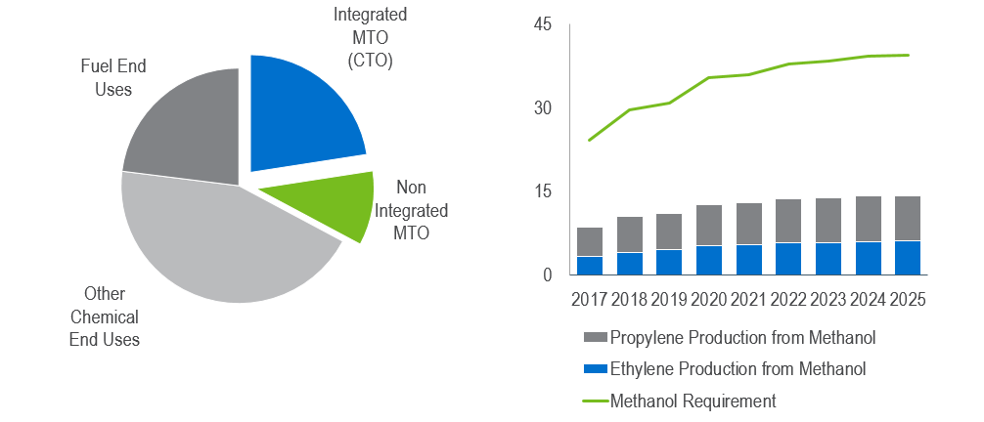
Over 10 million tons of olefins production requires 30 million tons of merchant methanol
Global Methanol Consumption by Derivative 2019-e = Approx. 105 million tons
Global Methanol Requirement for Olefins
(Million tons)
  Coalfield MTO (coal to olefins, CTO) is still competitive at lower oil, higher coal prices. MTO economics have been more challenging at lower oil prices. CTO will be the focus of investments
Notes:
Analysis accounts for integrated and non integrated methanol to olefins – due consequences on pricing.
14.6 million tons of methanol doesn’t enter the market, it is integrated straight into olefins production
Demand into olefins production, the fastest growing of the emerging markets, is now the largest single outlet for methanol, an end-use that has only been in commercial operation since 2010.

Slide 7
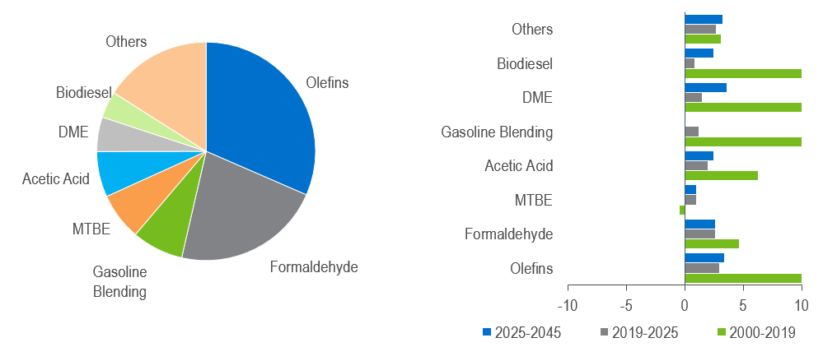
Methanol demand will grow at 4% per year to 2025, driven by olefins and gasoline blending
Global Methanol Demand by Derivative 2019-e = Approx. 105 million tons
Global Methanol Demand Growth by Derivative
(percent Volume Growth)
Approximately 3 tons of methanol is required for every 1 ton of olefin produced. Considering both integrated and non-integrated MTO demand, MTO has grown to become the largest derivative of methanol.

Slide 8
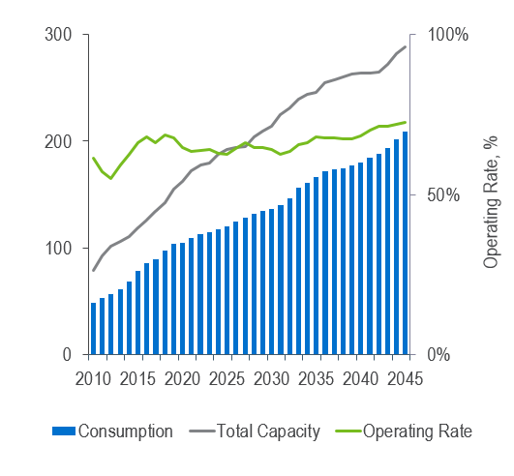
With demand now strongly linked to the olefins market, the methanol market will strengthen in the long term
Global Methanol Supply/Demand
(Million Tons)
    The methanol market was already in a period of oversupply with much capacity planned in many different countries
    The COVID-19 pandemic will exacerbate this for 2020 with no demand growth.
    Through the forecast, the operating rates will tighten as strong demand fundamentals remain once recovery from the pandemic as been achieved.
    The competitiveness of non integrated MTO units in lower crude oil scenarios still exists but is very challenging, and in the near term investment will slow in favour of integrated CTO which involve higher capital costs but offer greater profitability.
    The United States will develop capacity to become a net exporter by 2025.

Slide 9
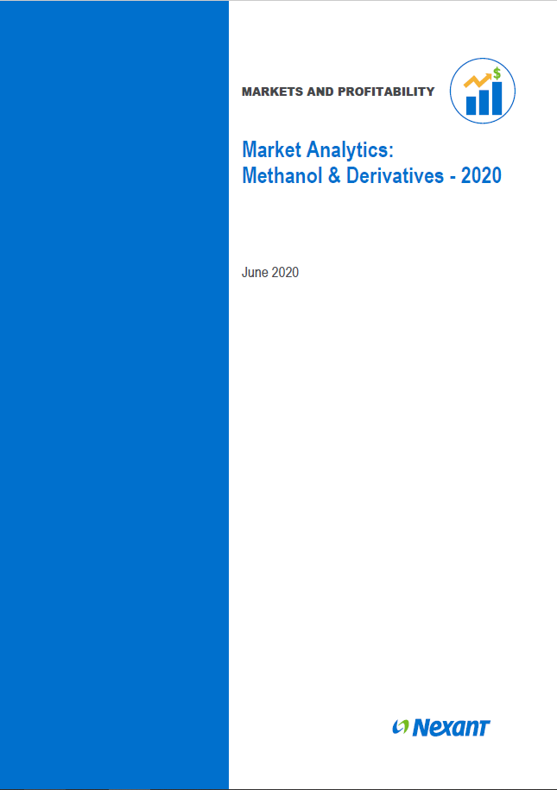
NexantSubscriptions.com
Find out more….
Market Analytics: Methanol – 2020
    Analysis and forecast to 2045 of supply and demand of the global methanol market including methanol, formaldehyde, MTBE and acetic acid.
    This analysis identifies the issues shaping the industry as well as provide detailed demand breakdown by derivative, supply and net trade data for 40 countries.
    www.nexantsubscriptions.com/reports/market-analytics-methanol-2020
For enquiries, please contact your regional Account Manager
Or,
Jeremy Belbin, Market Analytics Report Manager
    jbelbin@nexant.com
    Anna Ibbotson, Head of Markets and Profitability Program
    aibbotson@nexant.com

Slide 10
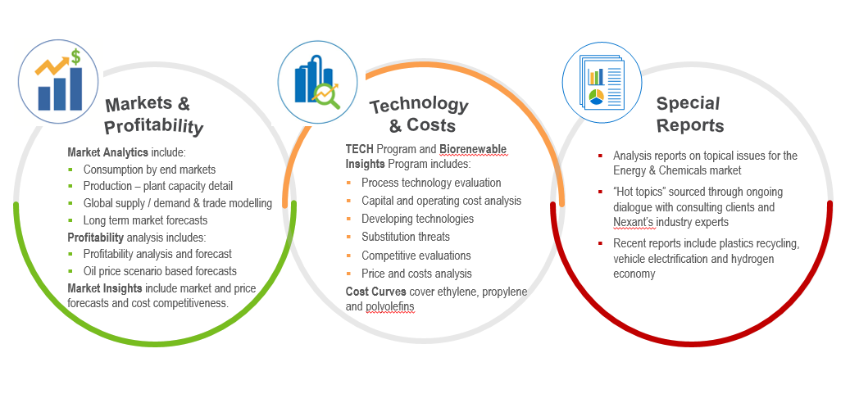
Subscriptions and Reports are delivered via three established programs – publishing over 100 reports per year
NexantSubscriptions.com

Slide 11
Markets and Profitability
Nexant
San Francisco
New York
Washington
Houston
London
Bahrain
Bangkok
Shanghai
Kuala Lumpur
“This Presentation was prepared by Nexant, Inc. (“Nexant”). Except where specifically stated otherwise in this Report, the information contained herein is prepared on the basis of information that is publicly available, and contains no confidential third party technical information to the best knowledge of Nexant. Aforesaid information has not been independently verified or otherwise examined to determine its accuracy, completeness or financial feasibility. Neither Nexant, Subscriber nor any person acting on behalf of either assumes any liabilities with respect to the use of or for damages resulting from the use of any information contained in this Report. Nexant does not represent or warrant that any assumed conditions will come to pass.
The Report is submitted on the understanding that the Subscriber will maintain the contents confidential except for the Subscriber’s internal use. The Report should not be reproduced, distributed or used without first obtaining prior written consent by Nexant. Each Subscriber agrees to use reasonable effort to protect the confidential nature of the Report.
Copyright © by Nexant Inc. 2020. All rights reserved.

