Slide 1

Market Analytics: Olefins – 2020
Abstract
Please view in Slide Show
Markets and Profitability
May 2020

Slide 2
Analysis and forecast of supply and demand in the global olefins market
Report Scope
Report Scope
Report Contents
Product Scope:
The olefins report includes ethylene, propylene and butadiene.
Geographic Scope:
Global
North America
South America
Western Europe
Central Europe
Eastern Europe
Middle East
Africa
Asia Pacific
Section 1: The Olefins Industry
1.1. Global Overview
1.2. Current Performance
Section 2: Ethylene
Section 3: Propylene
Section 4: Butadiene
Note: Sections 2-4 are segmented by geographic region and have the following outline
2.1.1. Consumption
2.1.2. Supply
2.1.3. Supply, Demand and Trade
Includes long term forecasts to 2045.

Slide 3
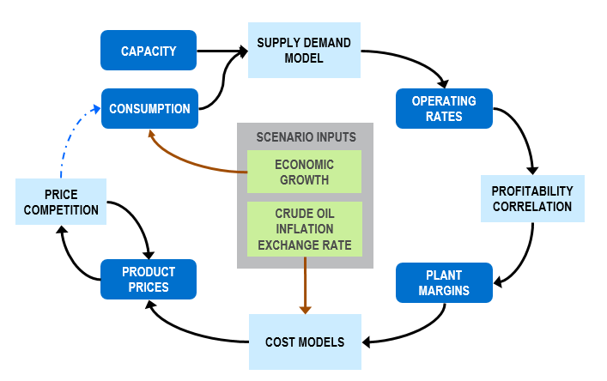
Markets and prices are inherently linked. Economic growth shapes markets via consumption. Crude oil drives costs
Methodology
Scenario Definition
    Primary Energy Prices
    (Crude Oil, Gas & derived feedstock)
    Economic Growth
    Inflation Rates
    Exchange Rates
    Petrochemical Asset Investment Profiles
Nexant Petrochemical Simulator
Nexant's Petrochemical Simulator tests assumptions of volatile operating environments with proven methodology.

Slide 4
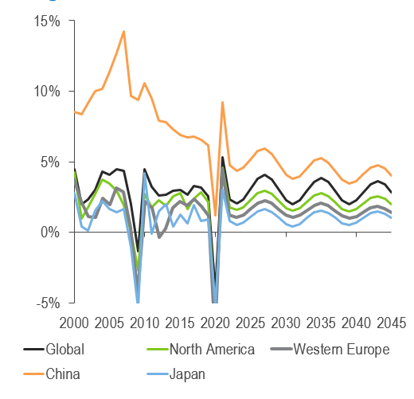
Global economic growth dropped to 2.5 percent in 2019, but is expected to contract by 4.2 percent in 2020
Underlying GDP Outlook
Regional GDP Outlook
    The impact of confinement measures will be an unprecedented contraction in the global economy.
    Those countries which successfully contained the outbreak already emerged from confinement and have achieved a rapid recovery in economic activity.
    Brazil and the United States have the largest ongoing infection rates, and infection rates in Africa are accelerating.
    Further confinement measures may be required to contain a second wave of infections.
    Minimal evidence of positive impact from lower oil prices.
    Growth over the coming years will be limited by high debts and job losses.

Slide 5
Global olefins markets were already sliding into crisis in late 2019, before the world had even heard of coronavirus
Key Findings
    Consumption
    2019 consumption growth continued to decline in 2019 as a result of economic issues, and the United States-China and other trade disputes.
    The coronavirus pandemic will cause a significant contraction in all of the olefins markets in 2020, although low oil prices and contamination risk undermine polyolefin recycling.
    Supply
    Numerous cracker starts in Asia and the U.S. already caused oversupply in late 2019.
    Vast additions of liquids cracking capacity is creating length in propylene and butadiene as well as ethylene.
    Oil price shock is cutting capex and delaying projects, with U.S. NGL production also hit.
    PDH still advantageous for some consumers although the global requirement for on-purpose propylene is reduced by the new Asian liquids crackers.
    Outlook
    The global market structure is changing. Multinational leaders like Dow are stepping back from new cracker developments, while Chinese private companies and Middle East national oil companies are building refinery/chemicals complexes.
    Surging supply of butadiene and benzene will impact naphtha cracking economics. Laggard plant closures are likely, and operators may hydrogenate and co-crack both C4s and pygas to avoid exposure to butadiene and benzene markets.

Slide 6
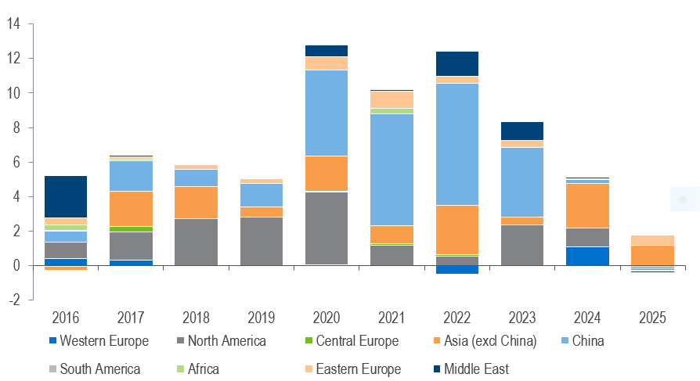
Ethylene Markets – Global
China’s capacity addition alone over 2020-2024 is greater than global addition over 2016-2019
Global Ethylene Capacity Growth
(Million tons per year)

Slide 7
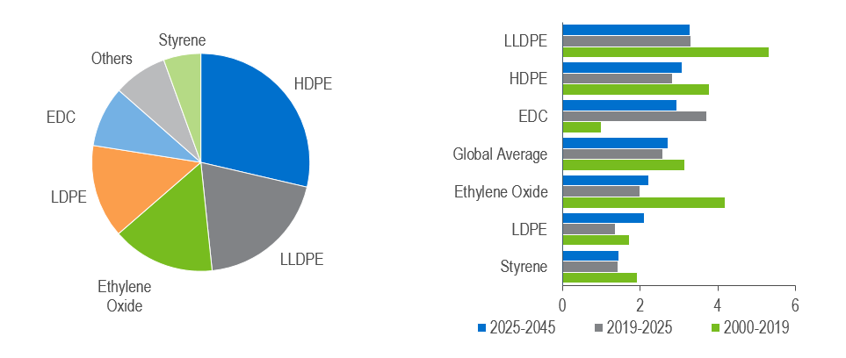
Ethylene Market – Global
Polyethylene accounts for 60 percent of global ethylene demand
Global Ethylene Consumption 2019-e = Approx. 161 million tons
Global Ethylene Consumption Growth by Derivative
(percent Volume Growth)
Global ethylene consumption is forecast to grow at an average annual growth rate of 2.6% to 2025, including a contraction in 2020.
Source: Nexant Analysis
Market Analytics: Olefins - 2020

Slide 8
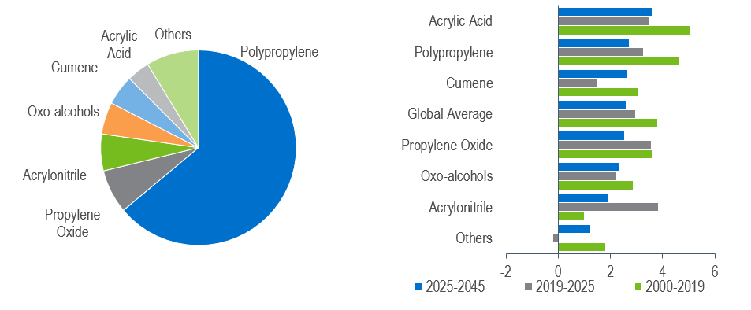
Propylene Market – Global
Polypropylene accounts two-thirds of global propylene demand, and 75 percent of growth to 2025
Global Total Propylene Consumption 2019-e = Approx. 110 million tons
Global Propylene Consumption Growth (percent Volume Growth)
Global propylene consumption is forecast to grow at an average annual growth rate of 3.0% to 2025, including a contraction in 2020 as a result of Covid-19
Market Analytics: Olefins - 2020

Slide 9
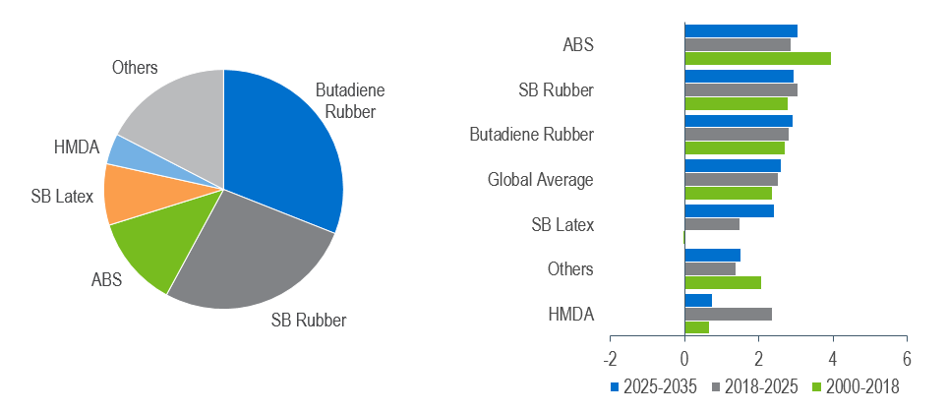
Butadiene Market – Global
Global butadiene demand growth dropped to two percent in 2019, due to low natural rubber prices and lower auto sales
Global Butadiene Demand 2019-e = Approx. 12.0 million tons
Global Butadiene Growth by Derivative
(percent Volume Growth)
The increasing vehicle parc in Asia is now translating into large-scale
replacement tyre demand.
Market Analytics: Olefins - 2020

Slide 10
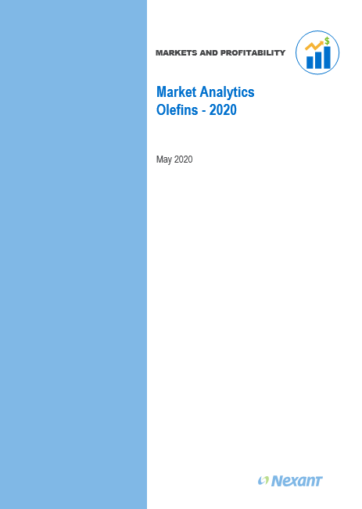
NexantSubscriptions.com
Find out more….
Market Analytics: Olefins – 2020
    Analysis and forecast to 2045 of supply and demand of the global olefins market including ethylene, propylene and butadiene.
    This analysis identifies the issues shaping the olefins industry as well as provide detailed demand breakdown by derivative, supply and net trade data for 40 countries.
    https://www.nexantsubscriptions.com/reports/market-analytics-olefins-2020
For enquiries, please contact your regional Account Manager
Or,
Stewart Hardy, Market Analytics Olefins Project Manager
    shardy@nexant.com
Jeremy Belbin, Market Analytics Report Manager
    jbelbin@nexant.com
    Anna Ibbotson, Head of Markets and Profitability Program
    aibbotson@nexant.com

Slide 11
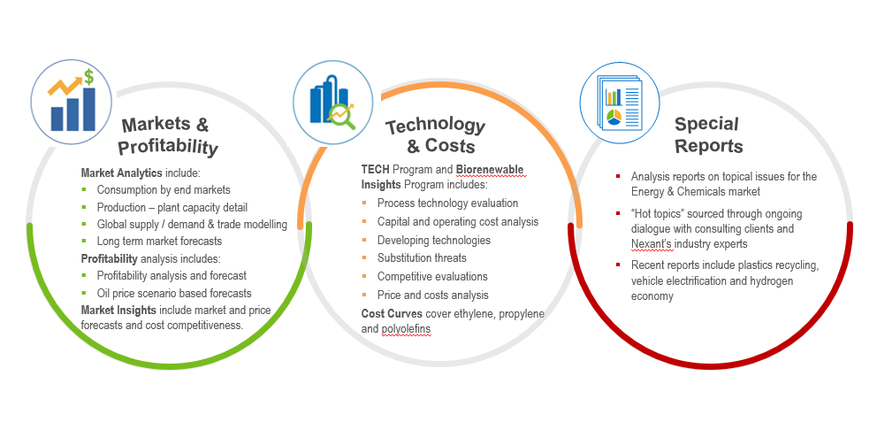
Subscriptions and Reports are delivered via three established programs – publishing over 100 reports per year
NexantSubscriptions.com

Slide 12
Markets and Profitability
Nexant
San Francisco
New York
Washington
Houston
London
Bahrain
Bangkok
Shanghai
Kuala Lumpur
“This Presentation was prepared by Nexant, Inc. (“Nexant”). Except where specifically stated otherwise in this Report, the information contained herein is prepared on the basis of information that is publicly available, and contains no confidential third party technical information to the best knowledge of Nexant. Aforesaid information has not been independently verified or otherwise examined to determine its accuracy, completeness or financial feasibility. Neither Nexant, Subscriber nor any person acting on behalf of either assumes any liabilities with respect to the use of or for damages resulting from the use of any information contained in this Report. Nexant does not represent or warrant that any assumed conditions will come to pass.
The Report is submitted on the understanding that the Subscriber will maintain the contents confidential except for the Subscriber’s internal use. The Report should not be reproduced, distributed or used without first obtaining prior written consent by Nexant. Each Subscriber agrees to use reasonable effort to protect the confidential nature of the Report.
Copyright © by Nexant Inc. 2020. All rights reserved.

